Slide 1
Media Copyright Query Resolution Agent
Our team consist of committed members who put their effort & gave their best and learned valuable AI lesson today
Vivek Tiwari
Pawan Verma
Shubham Shukla
Deepak Mathur
Sayyed

Slide 2
Problem Statement
Media companies face complex copyright rules.
Content creators need quick and accurate answers about usage rights.
Need for a fast ,automated,accurate guidance system.

Slide 3
Proposed Solution
We have created an AI agent that answers copyright questions in simple language.
Uses copyright laws, media policies, and licensing documents.
Searches documents and generates clear guidance + recommended actions.

Slide 4
Architecture
Document Loader: Reads .txt files
Search Engine: AI-based matching
Answer Generator: Uses OpenAI model
Output: Explanation, Permission, Actions

Slide 5
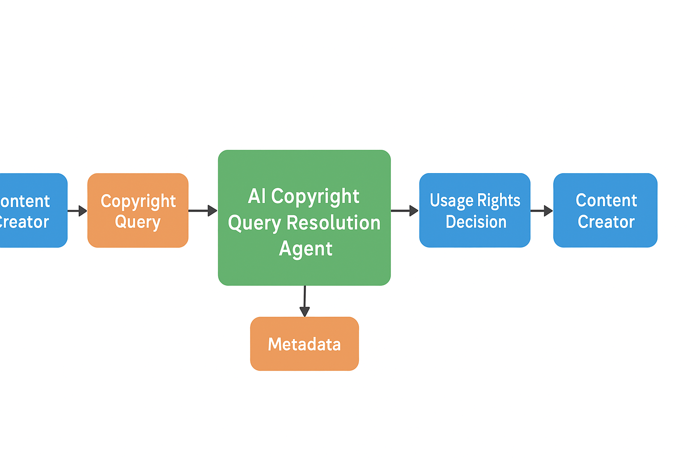
FlowChart

Slide 6
Benefits
Fast and reliable copyright answers.
Reduces manual legal checking.
Helps creators avoid copyright strikes.
Consistent, easy-to-understand responses.

Slide 7
Thank You

